Slide 1
Background
Cost per BOE – all expenses
Lifting Cost per BOE
Adds employee costs, general & administrative expenses and depreciation, depletion and amortization.
Upstream operating expense of wells and facilities, divided by BOE produced.
Lifting Cost ($/BOE) = Production (Operating) Costs ÷ Net Production Volume (BOE)
General ($/BOE) = All KOC Costs ÷ Net Production Volume (BOE)
The full absorbed cost of a barrel. Needs the finance general ledger feed.
Workover, rigless, ESP rental, maintenance, materials, fuel and utilities. Excludes G&A and DD&A.
The Production Supply Chain team built a working cost-per-barrel tool in Power BI.
It measures the operational cost of every KOC well and production facility.

Slide 2
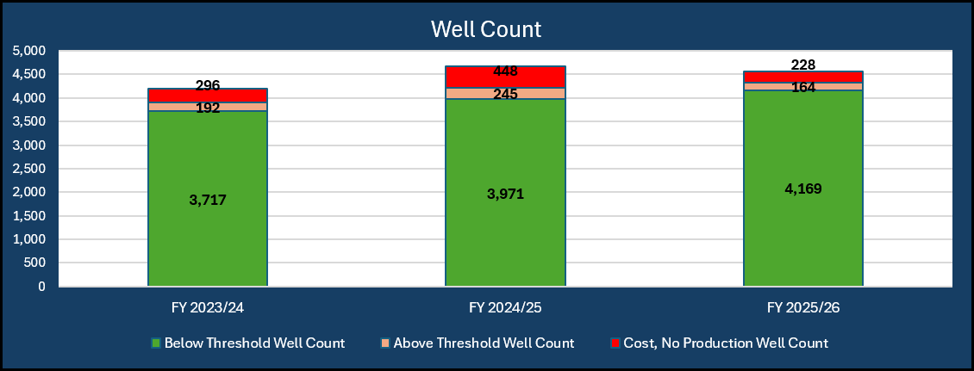
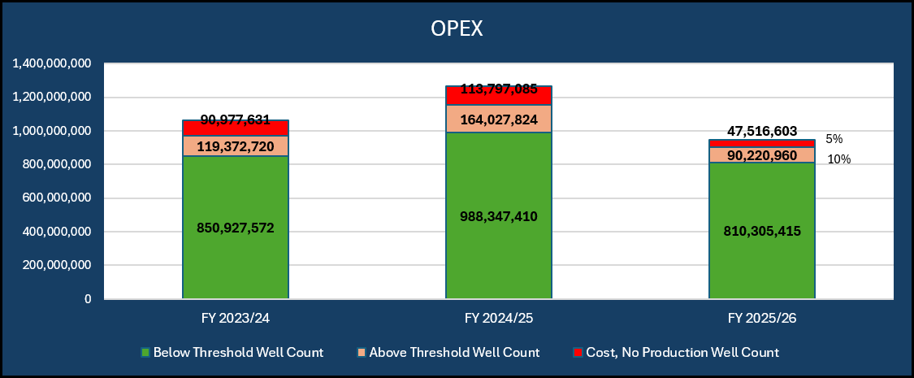
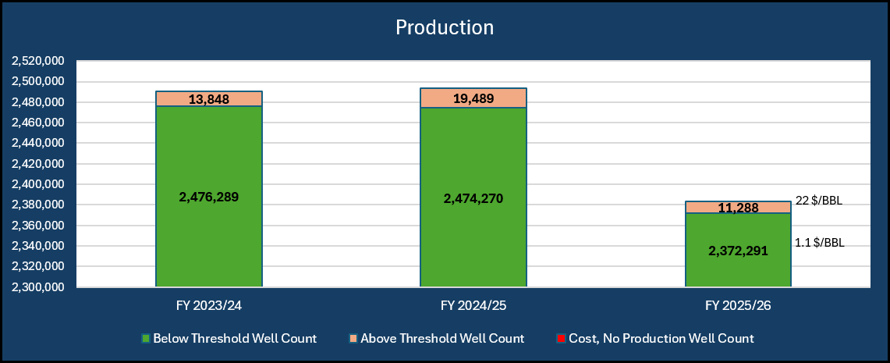
WELLS
Well Lifting Cost ($/BOE) = Cost on the well ÷ Well Net Production Volume (BOE)
Cost = Workover + Rigless + ESP
Production = Back Allocation
Wells with Cost
more than
15 $/BBL
Average Wells Cost/BOE
1.1 $/BBL

Slide 3
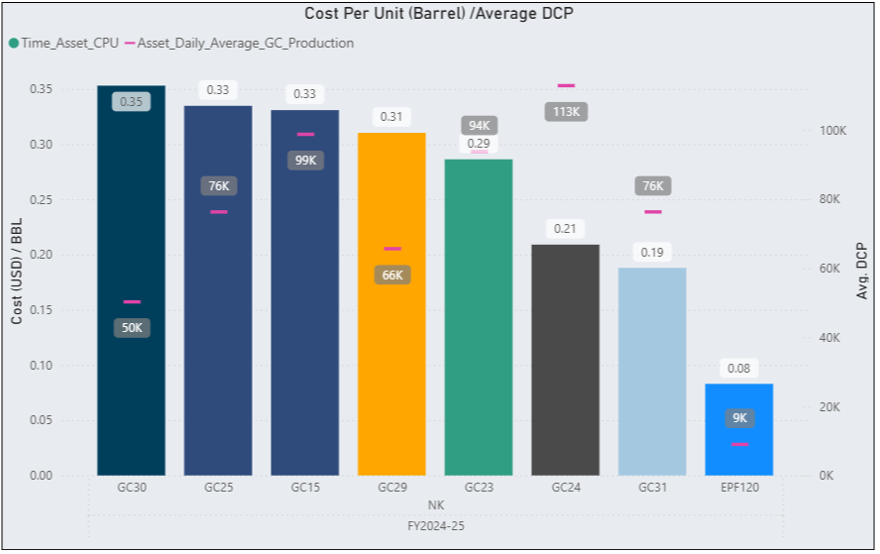
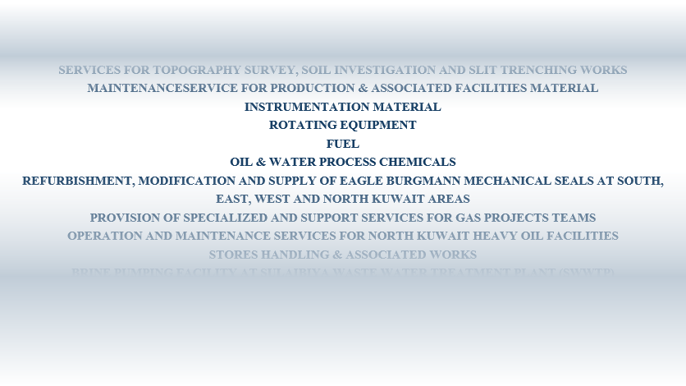
PRODUCTION FACILITIES
Facility Lifting Cost ($/BOE) = Cost on the Facility ÷ DCP
Cost = 793 ITEM

Slide 4
DATA SOURCES
System | Platform | Connection | Schema | Content
PIDIHUB production hub (SEABED) | Oracle | VWLTESTIMWHOUSE : 1521 service TPEARL | PIDIHUB_USR PIDIHUB_PROJ | Production allocation, PGOR well tests, DCP night figures, workover history, injection, forecasts
eBEAMS (Maximo) | Oracle | ebeamsrepdbd : 1531 service MAXREP | MAXIMO | Maintenance and lease contract expenses, materials, fuel, utility invoices
WSMS hub (TSMS) | SQL Server | mvcswsg11 database WSMS_HUB | PlanningSchema | Rigless jobs, MBO operable report details
Reference data | Excel | held by PIG today to be centralized | — | Asset-area, GC-asset, ops team, field names, gas wells, material grouping
Oracle Financials (GL) | Oracle | required for phase 2 | COA | Expense accounts and activities for full cost per BOE

Slide 5
TOTAL KOC EXPENCESS & COST/BOE
FY 2024/25
Directorate: SX01 S&EK
Group: SK01 Operations (SK)
Team: All
Accounts: All
Activities: All
Production: Allocation
Total expenses (selection)
Lifting cost portion
Non Operational (Overhead and DD&A)
Cost per BOE
$412M
$268M
$144M
$4.90
Lifting Cost Per BOE
$3.19
Account group | O – Operate | M – Maintain | W – Workover | G – General | MED / TWN | Total
71010100 Employee Costs | 38.2 | 22.5 | 8.1 | 24.7 | 6.3 | 99.8
72010301 WO Expenses | 96.4 | 71.2 | 31.6 | 6.9 | 4.2 | 210.3
75009100 Social Activities Expenses | 2.1 | 1.4 | 0.3 | 28.6 | 9.8 | 42.2
79010010 (LAND) DD&A | 31.5 | 18.9 | 4.6 | 3.2 | 1.5 | 59.7
Total | 168.2 | 114.0 | 44.6 | 63.4 | 21.8 | 412.0

Slide 6
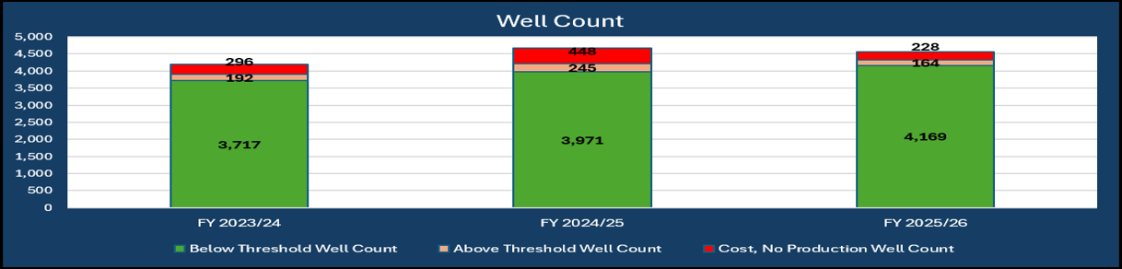


PROPOSED WELLS INTERFACE
FY 2024/25
Asset: All
Well type: All
Production: Allocation
Field: All
Cost/bbl threshold: $15/bbl
Well OPEX FY 2024/25
Average cost per BOE
Wells above threshold
OPEX above threshold
$2.4bn
$1.35
278
$185M
Wells ranked by cost per BOE — insight: the intervention shortlist; red bars breach the threshold
Lifting cost per BOE by fiscal year — insight: actual against target

Slide 7
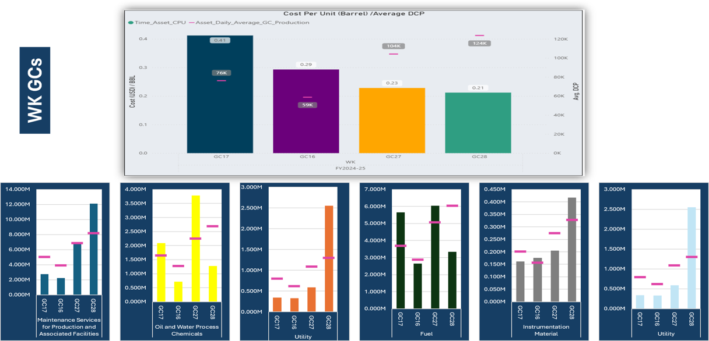
PROPOSED FACILITIES INTERFACE
FY 2024/25
Asset: All
Facility type: All
Production: DCP night figure
Cost/bbl threshold: $0.35/bbl
Facility OPEX FY 2024/25
Throughput
Cost per BOE
Facilities above threshold
$1.94bn
1.19bn BOE
$1.64
7

